Slide 1
Accessibility Access at Klamath Community College
Student Success Advisor/Accessibility Coordinator: Idaly Bustillos
Director of Retention & Student Success: Oscar Herrera

Slide 2
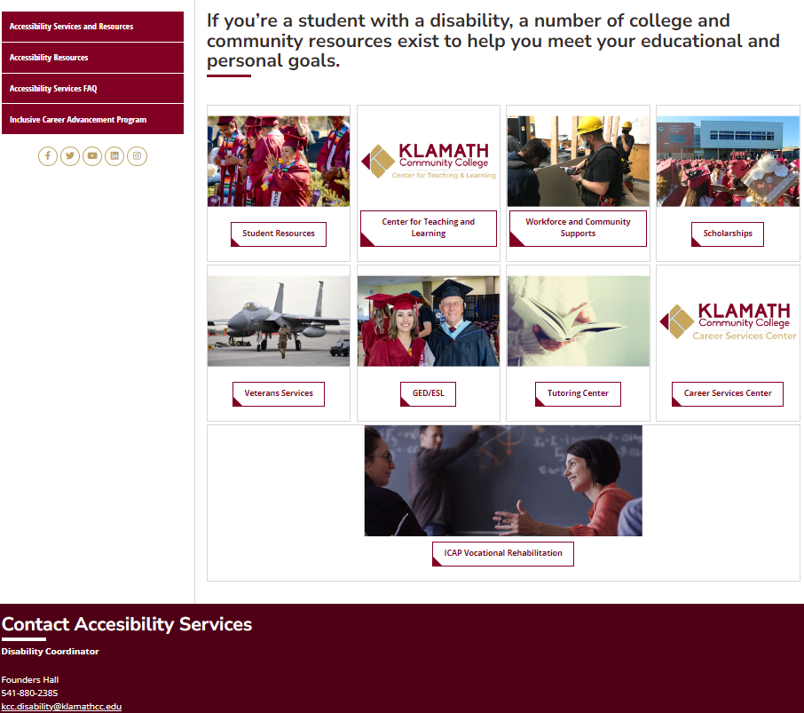
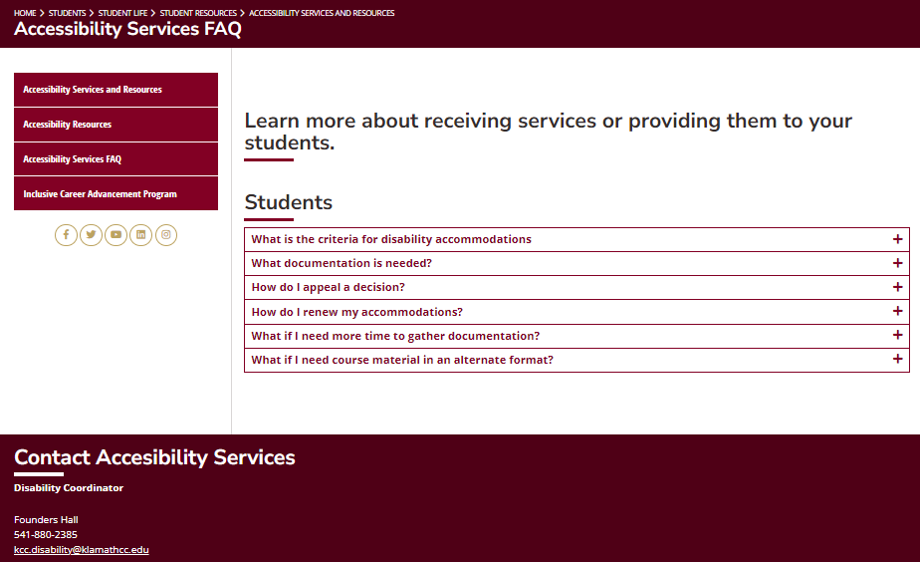
Mission:
To ensure that all students with disabilities have equal access to educational opportunities.
KCC has a student success disabilities coordinator who facilitates reasonable accommodations for qualified students and applicants with disabilities in accordance with the Americans with Disabilities Act and the Federal Rehabilitation act. A brochure for disabled students is available to increase the visibility of services. It is available in the Student Services and Disability Services departments as well as online.

Slide 3
The College places a high emphasis on ensuring unrestricted access for all.
Our facilities are open to the entire community and adhere to the accessibility requirements outlined in the Americans with Disabilities Act (ADA).
Beyond ensuring compliance with governing codes in the design and construction of all facilities, the College has appointed a Student Accessibility Coordinator.
This coordinator serves as a dedicated point of contact and advocate for individuals with special needs in matters related to ADA accessibility.
To streamline accessibility-related enhancements during facility remodels and reconstruction projects, the Facilities and Operations department has implemented an evaluation system. This system aids the College in prioritizing needs, identifying necessary resources and funding, and integrating accessibility improvements more efficiently into ongoing construction efforts.

Slide 4
Promoting Accessibility to our students
New student Orientation
Annual tour to the college for Klamath County HS students who have a documented disability
Include accommodations on Syllabus on each class
Referrals from faculty and other agencies
Participate in campus events

Slide 5
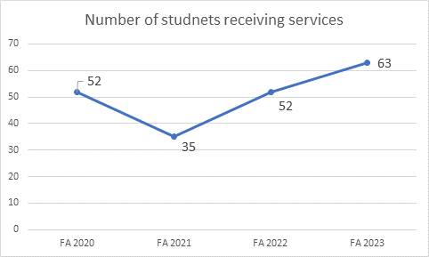
Who are we serving?
63 students Fall Term 2023 with documented service for accommodation
Represents 4.5% of the college credit students who are post high school
Registered in 20 different degrees – Support student into their interested
35% of the students are first generation to college students
Half of the students are taking 12 or more credits
Race and ethnicity, gender, and age demographics match the rest of the college population demographics

Slide 6
How does KCC accommodate Students?
Students complete the Access Application
Access will contact students to schedule an intake appointment, zoom, phone or in person
Access will review the documentation submitted by the student to review previous accommodations or their paperwork provided.
Together, the student and Access staff will determine appropriate accommodations.
What kinds of Accommodations
Testing center – A calm, quite place
Extended time for Tests and Quizzes
Assistance with Note Taking
E-books Text book in an Audio Format
Scribe Pens
Audio recorders
Weekly check ins /Advocating with faculty staff

Slide 7
At KCC, we strive to see students succeed and complete their degree or certificate programs. We host many activities to keep students engaged. And finally, we have many resources, here at the college and online, to help students succeed.

